Slide 1
FINANCIAL ANALYTICS
DETAILED PROJECT REPORT

Slide 2
PROJECT DETAILS
Project Title | Financial Analytics
Technologies | Data Science
Domain | Finance
Programming language used | Python
Other tools used | Ms Excel, Jupyter Notebook
Project Difficulty Level | Intermediate

Slide 3
Problem Statement
Without analyzing the competition, it is difficult for a business to survive. You are tasked to analyze the competition for the management to provide better results. This data set has information on the market capitalization of the top 500 companies in India.

Slide 4

ARCHITECTURE
Raw Data Collection
Load Dataset in Excel
Data Pre-processing
Importing libraries in Python
Real world
Insights
Data Modelling
Exploratory Data Analysis
Loading dataset
Reporting

Slide 5
Dataset Information
Name: Name of the companies
Mar Cap – Crore: Market Capitalization in crores
Sales Qtr. – Crore: Quarterly Sale in crores

Slide 6
Importance of each attributes
Name: Provides us with the company name
Mar Cap – Crore: Market Capitalization is a key metric in financial analysis, especially when assessing the
size and value of the company. It represents the total market value of a company’s outstanding shares of
stock and is calculated by multiplying the current share price by the total number of outstanding shares.
Sales Qtr. – Crore: Quarterly sales figures play a crucial role in financial analysis by providing insights into
a company’s revenue generation, growth prospects , market competitiveness.

Slide 7
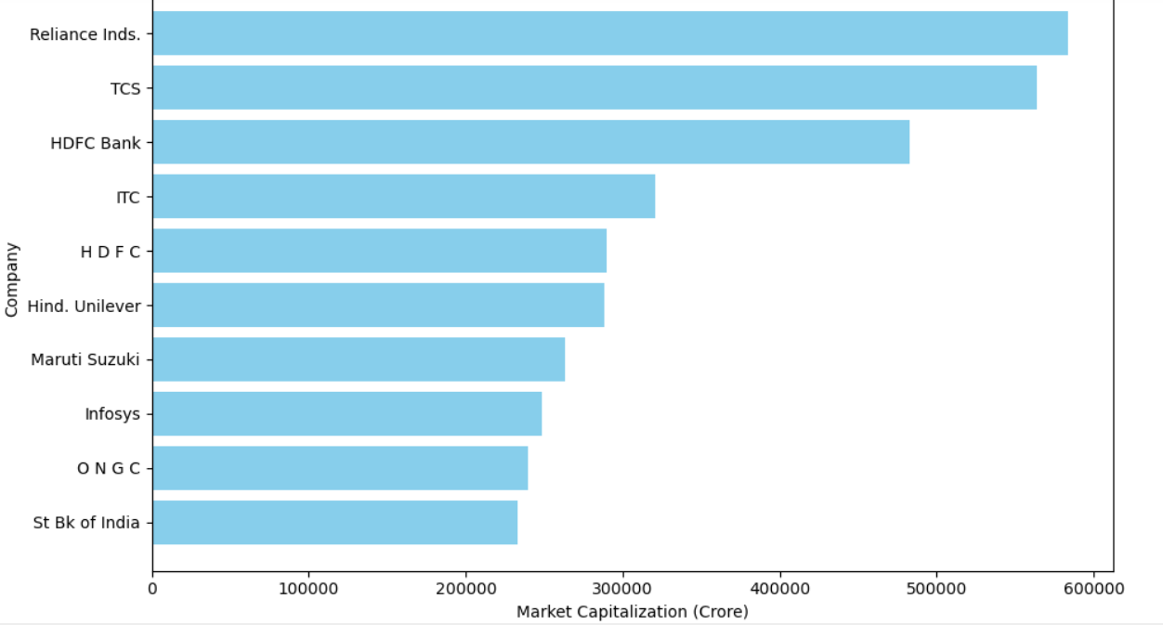
INSIGHTS
Top 10 Companies by Market Capitalization
Reliance Inds. is the top company with a Market Capitalization of 583436.72 Crores . And then
TCS , HDFC Bank and so on.

Slide 8
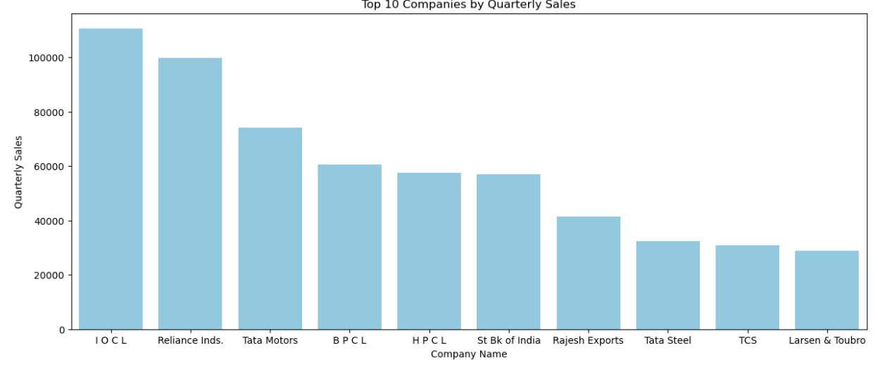
IOCL is the top company considering quarterly sales . Reliance Inds. follows.

Slide 9
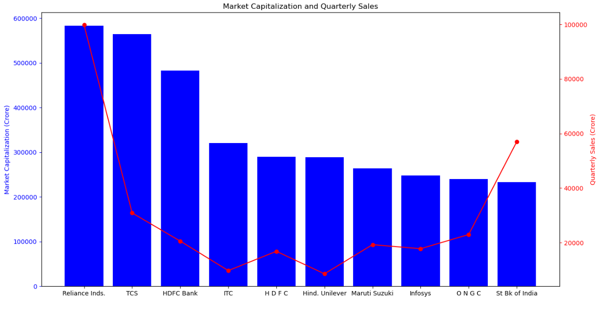

Slide 10
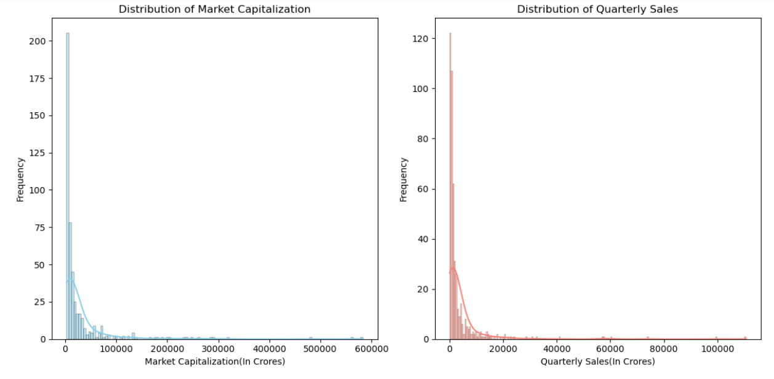

Slide 11
KEY PERFORMANCE INDICATOR
Top Companies by Market Capitalization
Top Companies by Quarterly Sales
Distribution of Quarterly Sales and Market Capitalization
Relation between both attributes

Slide 12
CONCLUSION
Reliance Inds. is the top company with a Market Capitalization of 583436.72 Crores And then TCS , HDFC Bank and so on.
IOCL is the top company considering quarterly sales . Reliance Inds. follows.
Most of the companies Market Capitalization is seen under 100000 Crores and Quarterly sales under 20000 Crores.

Slide 13
THANKYOU

